Slide 1
Marketing update
By Brenda Maas

Slide 2
Dashboard image here
Notes:
Facebook is down but Instagram is far exceeded expectations – typical of a “new” social media platform
Will adjust by using some of budget to “boost” Facebook posts, starting with the mini-campaign.
Will also experiment with posting events (we need your help here, Board with your community contacts)
Call center volume is low but slightly up from FY17 Q2. Expect big changes in those numbers with micro-site and new website in March.
Am adjusting Tguide numbers to reflect – implemented a January inventory protocol for Tguides.

Slide 3
Social Media
By Michele Flanagan

Slide 4
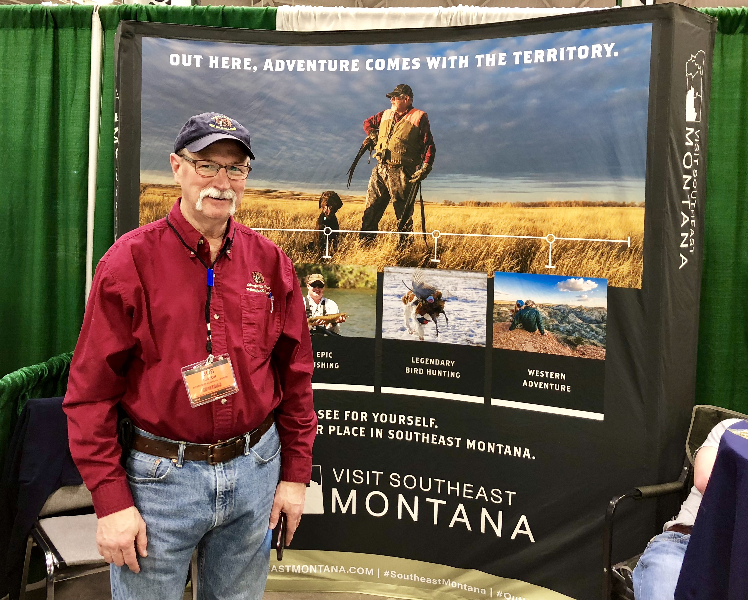
Since last time:
· Marketing plan and budget approved by TAC
· Image Library + Video – shot in region this week
split budget FY18-19
· Travel Guide – making progress
· fam tours
Australian & new Zealand agents/brand usa 8/17-19
barefoot theory (leisure travel & adventure)
andy Austin (leisure travel & adventure)
mark bedor (western & history)
jonanathan vandevoort (Netherlands)
luc decoudin (France – Michelin guide)
·
· trail to the little bighorn - news release & map
·
Notes:
Scenic Maps -- printed 10,000
Image Library – do you know of any video footage?
Northwest Sportshow - 32,683, up from 31,270 in 2017.
Roundup International – these are long-term relationships
Influencers – Andy & the Van - $2400 includes 6 photos/day of BCNRA & Terry Badlands
+ Barefoot Theory

Slide 5
· Scenic maps done – his·
Notes:
Scenic Maps -- printed 10,000
Image Library – do you know of any video footage?
Northwest Sportshow - 32,683, up from 31,270 in 2017.

Slide 6
ince last time:
· Scenic maps done – history map next
· Image Library + Video production
split budget FY18-19 – Lining out may & june
· Travel Guide (covered earlier)
· Northwest Sportshow – with fwp personnel
· Roundup International ~38 tour operators
· ·Influencers & Media Tours - scheduling
·
Notes:
Scenic Maps -- printed 10,000
Image Library – do you know of any video footage?
Northwest Sportshow - 32,683, up from 31,270 in 2017.

Slide 7
Ongoing Initiatives:
· continue with website content
news room –ties to:
· earned media
· history map - finalize
· Image Library + Video production - ongoing
split budget FY18-19
· Travel Guide – mid-summer release
· Influencers & Media Tours - scheduling more
· special cowboy moments on rfd tv
· in-region travel for social media content
· more presentations to partners within region

Slide 8
Marketing update
The END

Slide 9
Warm Season Campaign Report
March – October FY7 Warm Season Final
Performing above industry average with .26%
Made adjustments to under-performing iExplore & saw improvement
Working with Windfall to analyze under-performing TripAdvisor
Top geo-markets: Seattle-Tacoma; Portland; Denver and Minneapolis
Notes:
CTR - .26% > industry average for tourism of .15%.
*The Interfuse article on the SEMT website has received 10,177 clicks/pageviews, 2:05 is the average time on page which is higher than the site average. Top performing geo targets are: Seattle-Tacoma, Portland, Denver, and Minneapolis

Slide 11
Notes:
FY18 Media Plan – note run dates.

Slide 13
Looking Forward
Reveal new website & creative this spring
Incorporate Out Here campaign into all aspect
Thoughts on region-specific research (for FY19)?
Beth Burman Frazee
Jim McGowan
Erika McGowan
Kyle McGowan
Megan Richter
Tia Metzgar

