Slide 1
Marketing update
By Brenda Maas

Slide 2
Dashboard image here

Slide 3
Dashboard image here

Slide 4
Website snapshot
Month | Unique Visitors | Visits
Jun-18 | 6639 | 8029
Jul-18 | 7866 | 9315
Aug-18 | 5991 | 7123
Sep-18 | 4699 | 5575
Oct-18 | 4513 | 7010
 | 29708 | 37052
Southeastmontana.com
Notes:
2 specific points:
1. compare unique visits to last year
2. note time of year when considering downward trend – will be good to see this year-over-year
Yellowstone Journal RS was so good (~3,000 leads/month) that we have or could exceed the budgeted $ for fulfillment and postage. Have enough to last the FY but had to modify.
New plan: Hold the RS and fill only organic requests – push more on social & e-blasts to include “to request a guide” strategy – confirmed by JB & Windfall.
Ties social to e-blasts

Slide 5
Top States
Year-to-Date:
Texas
Minnesota
Wisconsin
Illinois
California
Florida
Notes:
NOTE: only fulfilled guides from top 10 states as IDed by Brenda

Slide 6
Social Media
By Michele Flanagan
Notes:
And a 2018 study by social media analysts at Rival IQ reports that the median Facebook engagement rate across all industries surveyed is 0.16%.
This post was 0.10%
Engagement rate = engagements/reach

Slide 7
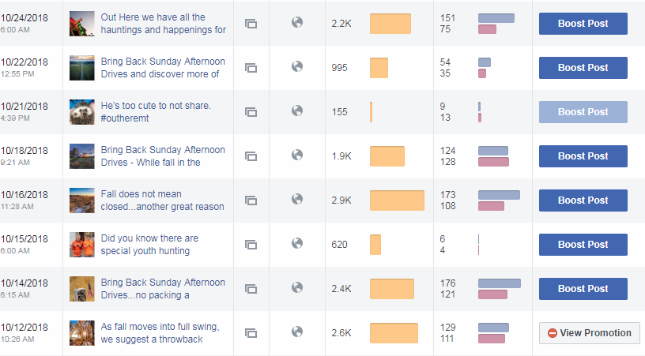
Social Media
By Michele Flanagan

Slide 8
Social Media
By Michele Flanagan

Slide 9
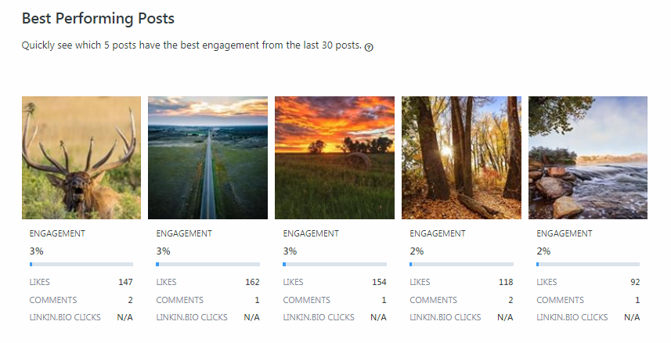

Slide 10
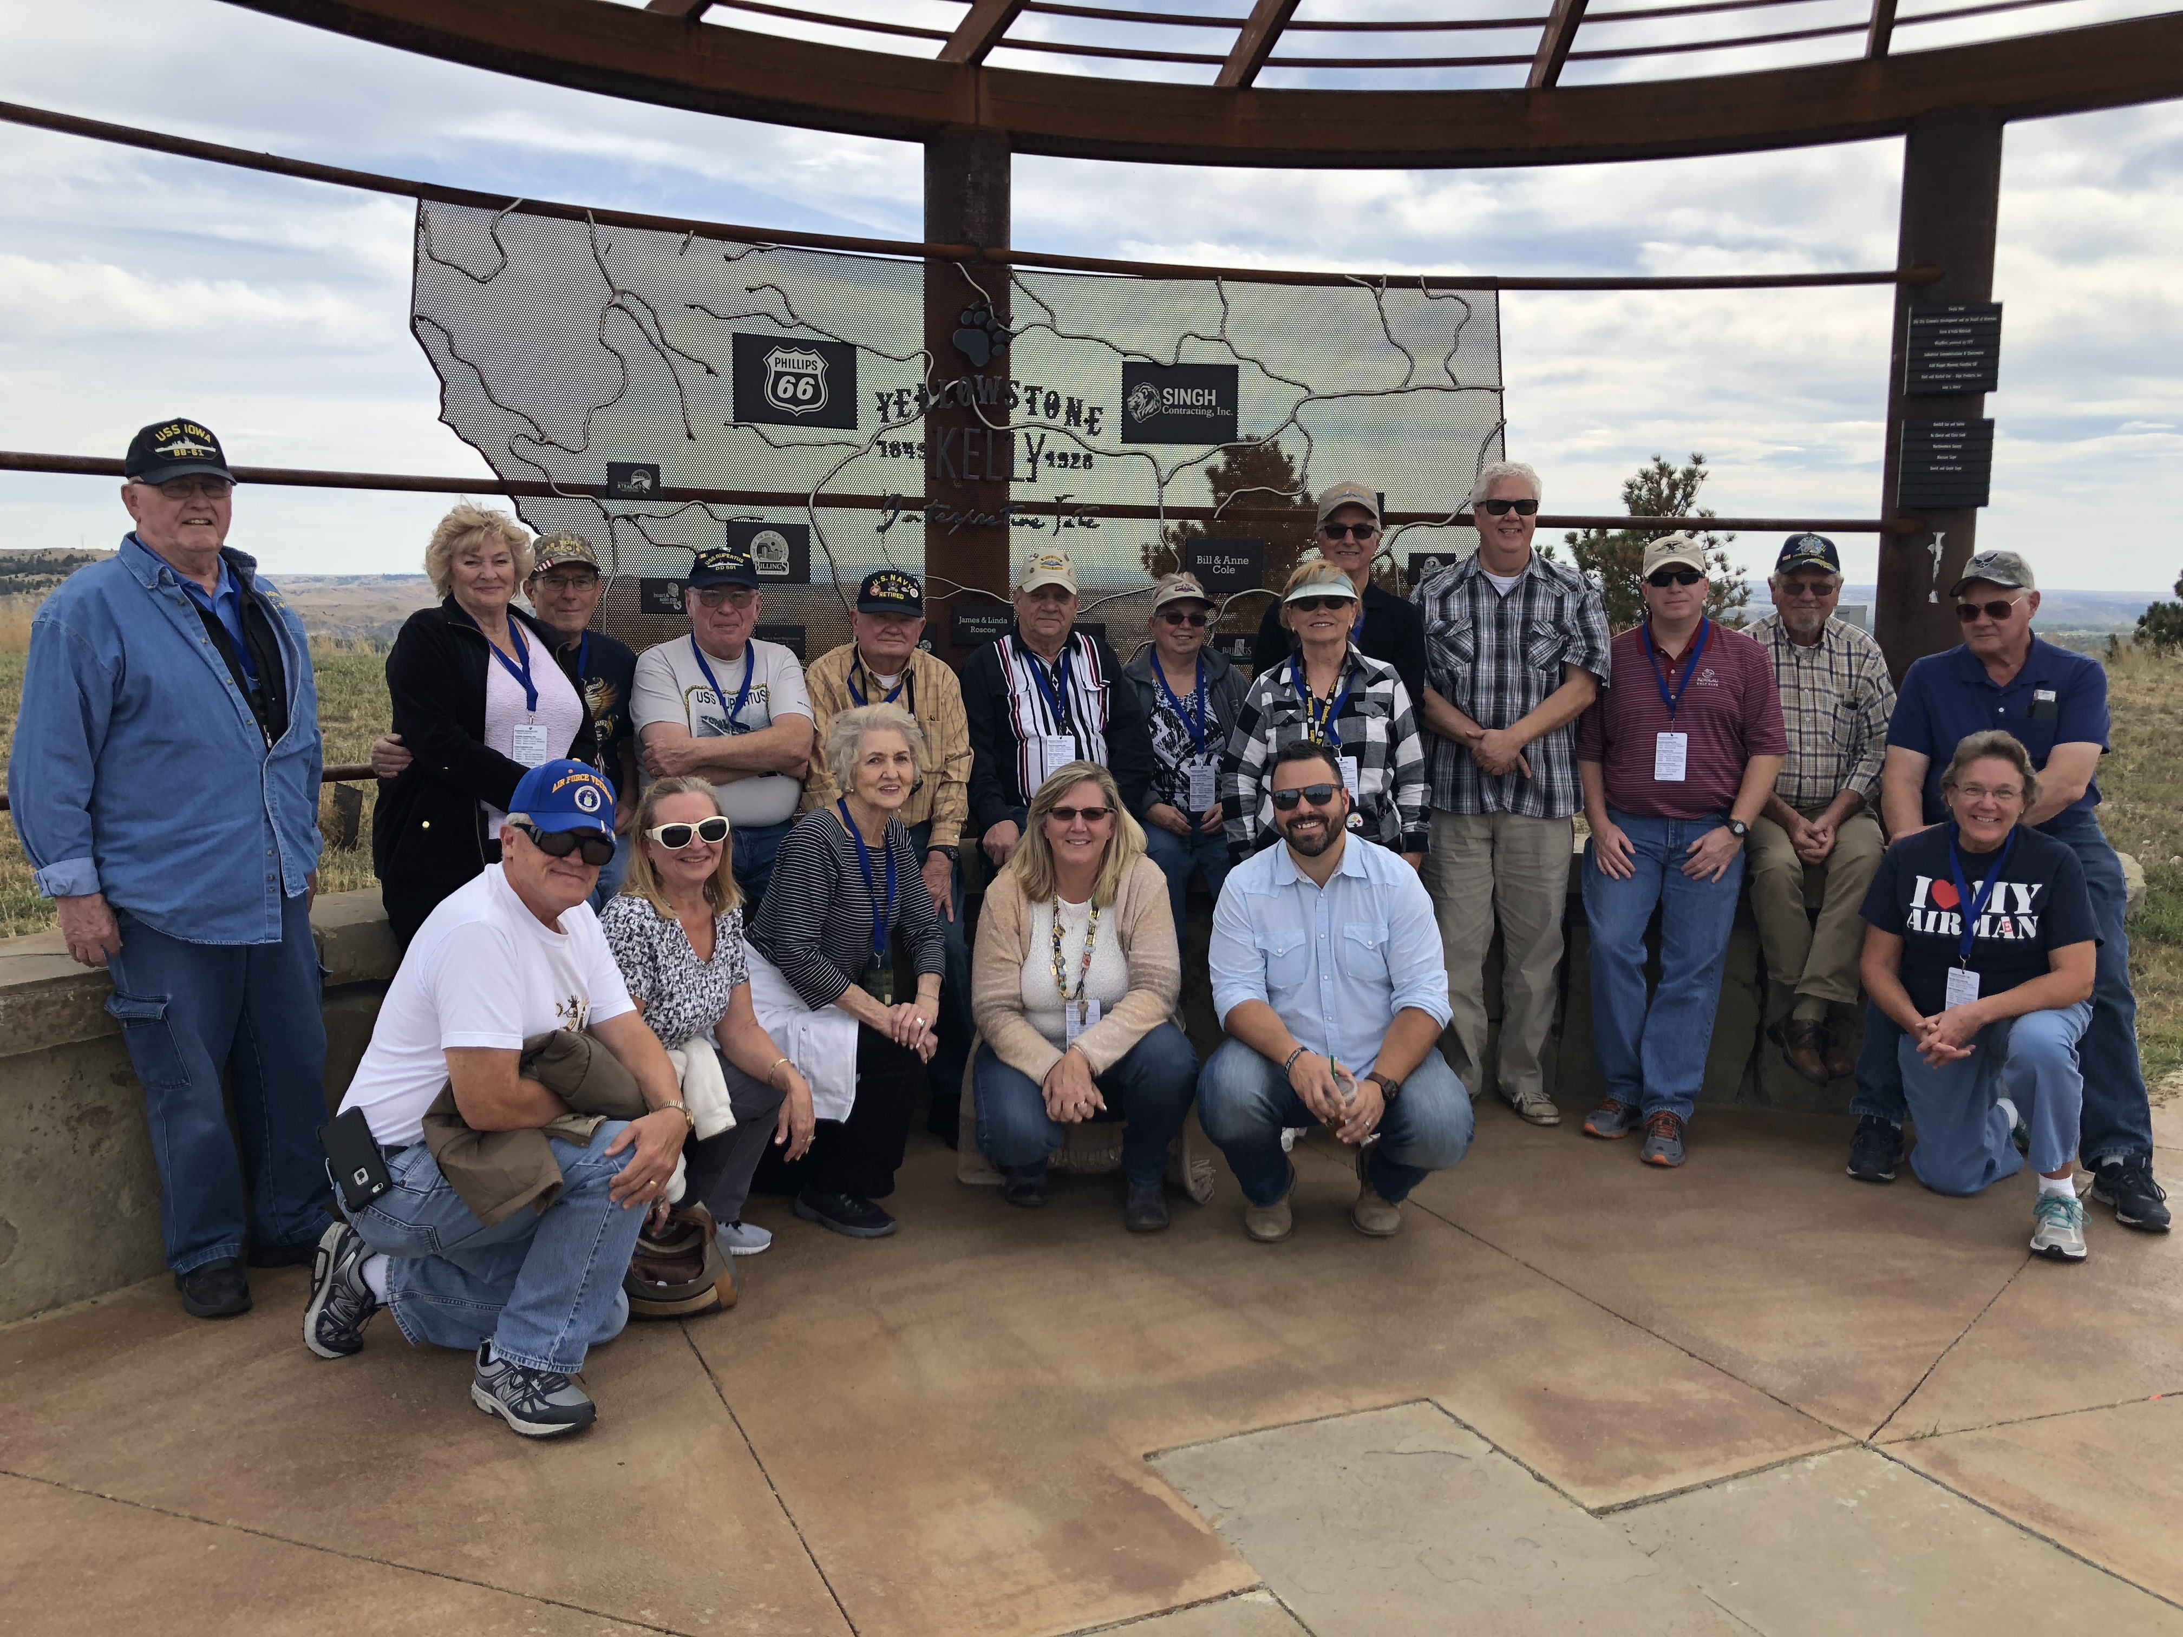
Since last time:
· developing strategy & Fy19 media plan – team windfall
· MORE Image Library + Video – shot in region this week
split budget FY18-19
· Travel Guide 2019 in progress
· Historical maps distributed (41scenic & 42 historic)
· fam tours
13 military planners
· social media - scheduling 2019 influencers now
· earned media FY18 work starting to show up

Slide 11
Earned media
Hosted journalist Mark bedor in June, 2018
Cowboys & Indians
AQHa/cavalry school
Quigley shoot/pbs & cowboy channel
Others:
Special cowboy moments
Wild rides
Terry badlands/Missoula public radio
Notes:
1/3 page ad in C&I = $3,087
working

Slide 12
Ongoing Initiatives:
· website content + optimization + seo
learn more from team windfall’s presentation
· earned media & Influencers & Media Tours
- strong focus fy19 -
· integrating all channels
· new and/or update itineraries – marketing committee
· image Library + Video production
- push out in January 2019
· Travel Guide – looking ahead – April 1st ship date
· special cowboy moments on rfd tv – DATE to be announced
· marketing workshops for tourism partners
· more presentations to partners within region

Slide 13
Marketing update
The END

Slide 14
What Is TBEX?
Travel Blog Exchange
Largest conference and networking event for travel bloggers, online travel journalists, new media content creators, travel brands, and industry professionals.
The Travel Media Community
No other event or conference offers an opportunity to connect with this amount and level of travel bloggers, influencers, and travel journalists in the United States.

Slide 15
· Scenic maps done – his·
Notes:
Historic Maps -- printed 10,000
42 pads = 4,200 distributed to date

Slide 17
Notes:
Scenic Maps -- printed 10,000
Image Library – do you know of any video footage?
Northwest Sportshow - 32,683, up from 31,270 in 2017.

Slide 18
The Impact of TBEX Attendees:
More than 6% of TBEX attendees have a reach of over one million followers.
34% are considered professional influencers with a reach ranging from 10,000 to 1 million followers.
56% of TBEX attendees are micro-influencers.

Slide 19
Impact of TBEX Attendees:
Influencers and bloggers with reaches of more than one million have a creative fee of anywhere between $75k and $150k.
Conservatively, if 600 influencers attend and 6% have one million+ in reach, it would cost roughly $2.7 million to bring those same individuals to the region - in creative fees alone.
Notes:
Scenic Maps -- printed 10,000

Slide 20
Influencer/Content Marketing
Delivers 11x higher ROI than traditional forms of digital marketing
Is 62% less expensive than traditional marketing and drives nearly 3x as many leads.
49% of people say they rely on recommendations from influencers when making purchase decisions.

